Slide 1

Process
Lecturer: VU THI MY HANG
Operating System

Slide 2
Plan
Process concepts
Process features
Process operations
Interprocess Communication (IPC)

Slide 3
Plan
Process concepts
Process features
Process operations
Interprocess Communication (IPC)

Slide 4
Process vs. Program
Process concepts
Source code
(i.e., set of instructions in a high-level programming language)
Compiled
Object code
PROGRAM
Static entity
Linked with libraries
A process is a program in execution
Executable code
Loaded into memory
Image of executing program (executable code, associated resources)
PROCESS
Dynamic entity

Slide 5
Plan
Process concepts
Process features
Process operations
Interprocess Communication (IPC)

Slide 6
Process state
Process features
Events arriving
and resources available
Ready
Blocked
Wait for CPU
Wait for events or other resources (not CPU)
CPU available
Running
New
Exit

Slide 7
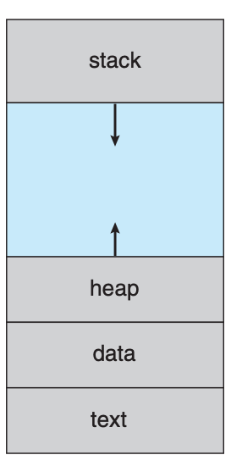
Process address space
Process features
OS
Function parameters, return values and local variables allocated automatically as a process loaded into memory
P1
P2
Variables allocated dynamically during process run time (e.g., objects, pointers)
…
Global (and/or static) variables
Program code (i.e., set of instructions)
Memory partitions
Address space reserved for each process

Slide 8
Process address space
Process features
public class Addition {
public int add(int a, int b) {
int sum = a + b;
return sum;
}
}
void main() {
Addition obj = new Addition();
printf(obj→add(12, 25));
}
a
b
sum
obj
real obj
Where to find a, b, and sum in memory?
What about obj?

Slide 9
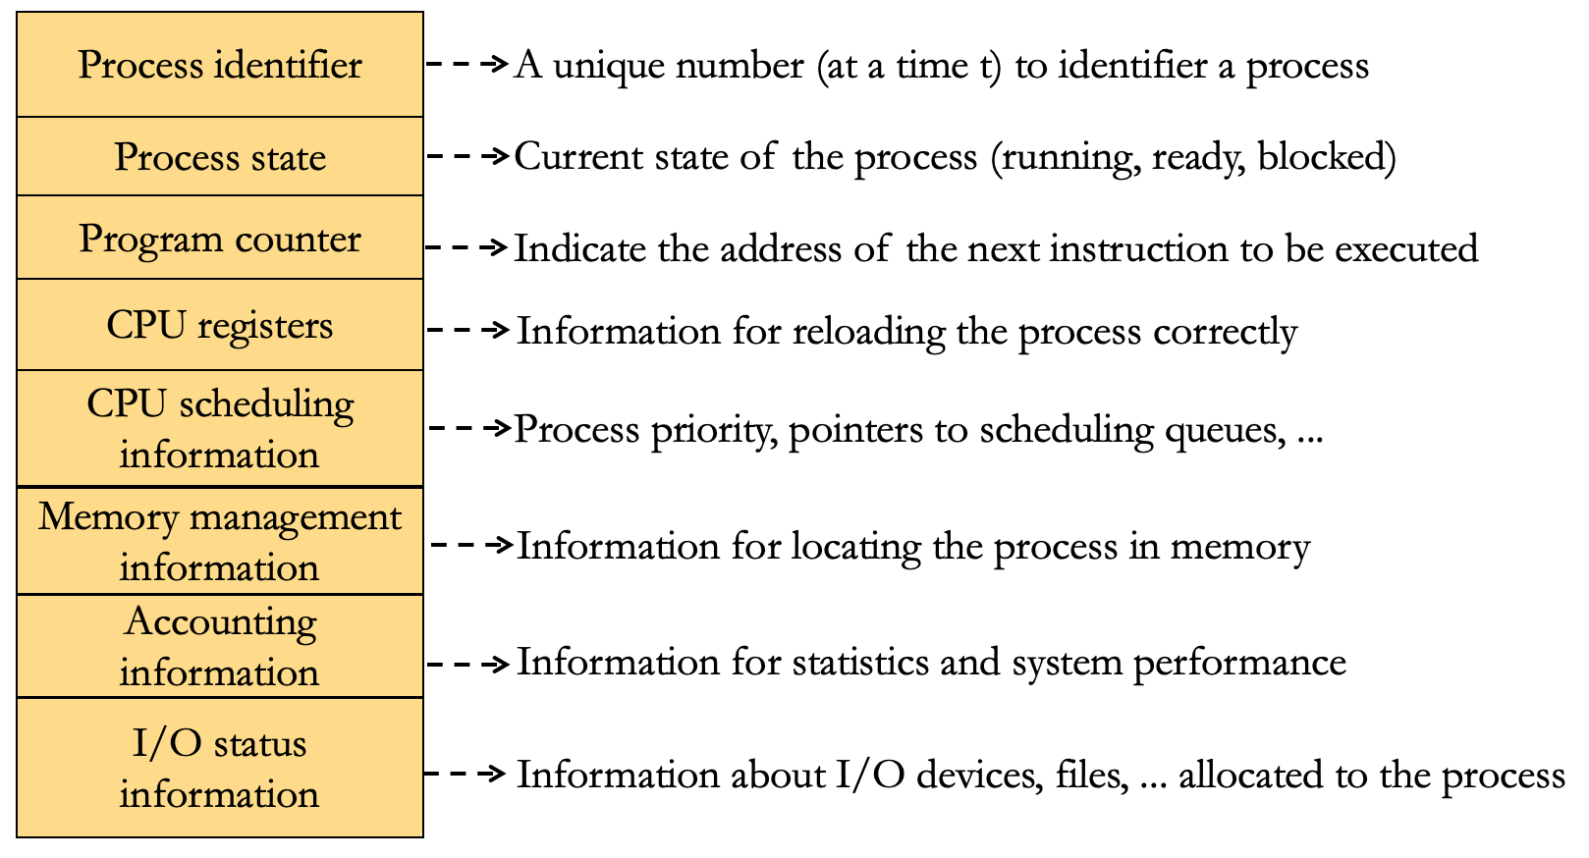
Process Control Block (PCB)
Process features
Specific data structure
Contains process information
Located in OS address space and accessible only in kernel mode
PCB1
PCB2
PCB3
...
Process Table
Used by OS to manage processes
PCB3

Slide 10
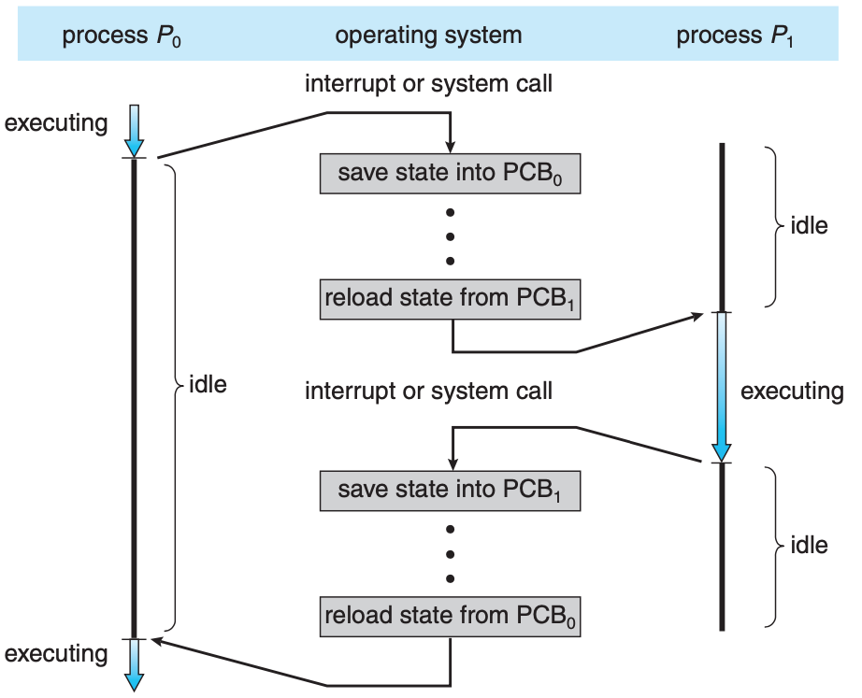
Context Switch
Process features

Slide 11
Plan
Process concepts
Process features
Process operations
Interprocess Communication (IPC)

Slide 12
Process creation
Process operations
A parent process create children processes, which, in turn, may create their own children processes
System calls: fork (Unix), CreateProcess (Windows)
A child process may:
be a duplicate of its parent (i.e., have same memory space with its parent)
load another program to execute
System call: exec (Unix)
When a new process is created:
It will be allocated a process identifier (pid) and other resources
A PCB containing the information of new process will be created and placed in Process Table

Slide 13
Process creation
Process operations
pid = 20
child process
pid = 21
pid_t = 0
pid_t = fork()
#include <unistd.h>
#include <stdio.h>
main( ){
int pid_t = fork( );
if ( pid_t ==0) { //child execution
printf(“%d is a child of parent %d”, getpid(), getppid());
}
else if ( pid_t > 0) { //parent execution
printf(“Parent %d created a child %d”, getpid(), pid_t);
}
else { error }
}
parent process
pid = 20
pid_t = 21
print 21 20
print 20 21

Slide 14
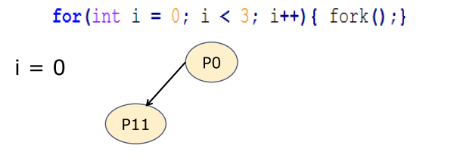
Process creation
Process operations
Process Tree

Slide 15
Process creation
Process operations
Process Tree

Slide 16
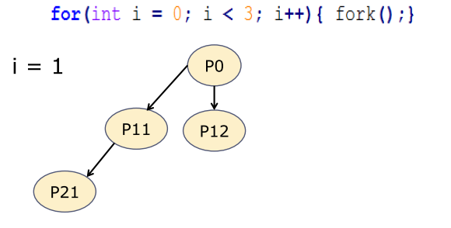
Process creation
Process operations
Process Tree

Slide 17
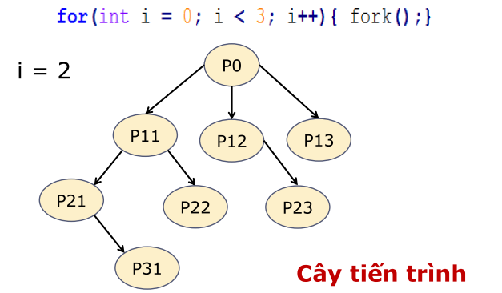
Process creation
Process operations
Process Tree

Slide 18
Process termination
Process operations
A process may terminate when finishing its execution or be terminated by its parent or OS processes
System call: exit (Unix), ExitProcess (Windows)
Zombie processes
A child terminates, but its PCB has not released yet
→ The parent must “wait” for its children to complete
System call: wait (Unix), WaitForSingleObject (Windows)
Orphan processes
Parent terminates, but children still exist
→ orphan processes → assigned to “root process”
Cascading termination

Slide 19
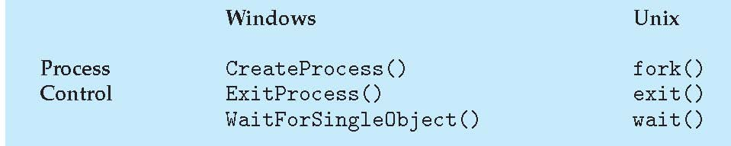
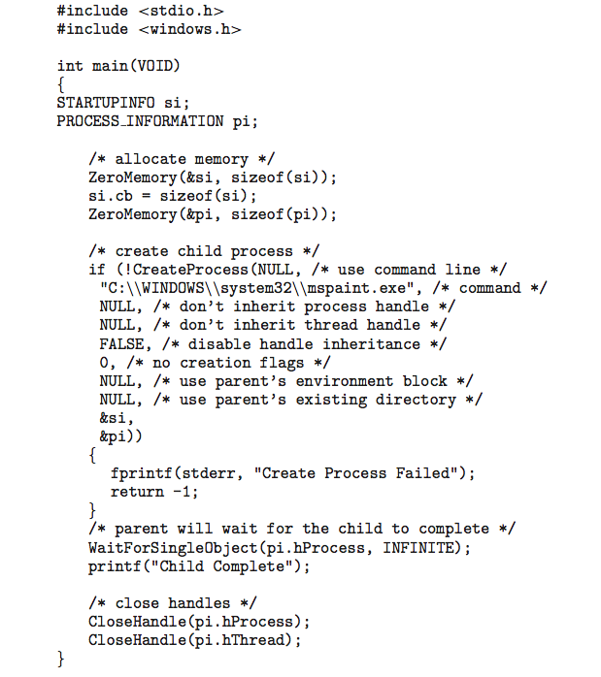
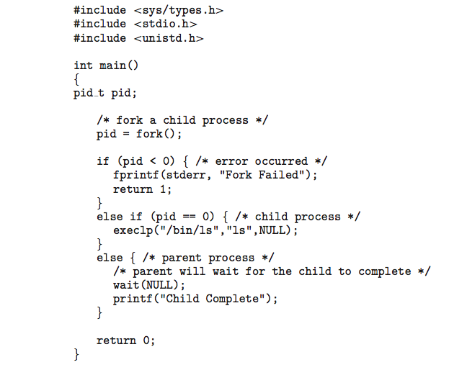
System Calls for Process Management
Process operations
Linux example
Windows example

Slide 20
Plan
Process concepts
Process features
Process operations
Interprocess Communication (IPC)

Slide 21


Overview
Interprocess Communication (IPC)
IPC provides the way in which processes communicate to each other.
Exchange/Sharing data
Cooperate to accomplish a task

Slide 22

Pipe
Interprocess Communication (IPC)
Unidirectional communication
Sending data in a one-way direction
Consists of two processes: writer and reader
Two kinds of pipes
Ordinary pipes (i.e., anonymous pipes): two communicating processes must have a parent-child relationship
Named pipes: two communicating processes do not need to have a parent-child relationship
Writer
Reader

Slide 23
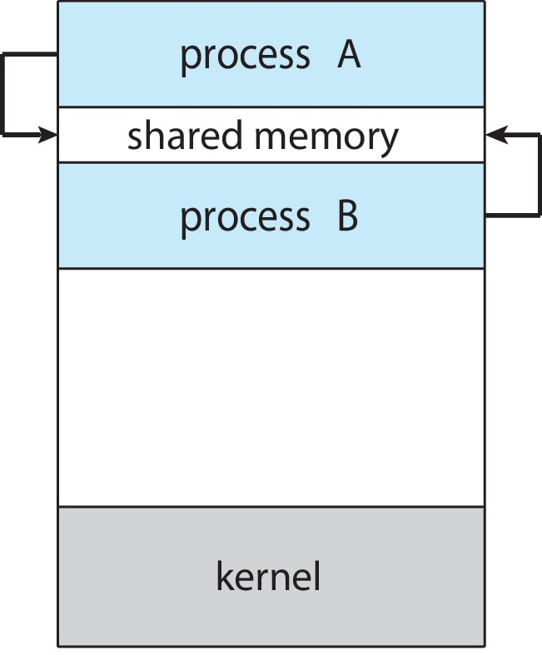
Shared Memory
Interprocess Communication (IPC)
Processes make communication via a shared memory
Shared memory resides in address space of the process that created it
Generally, memory sharing requires a synchronization mechanism

Slide 24
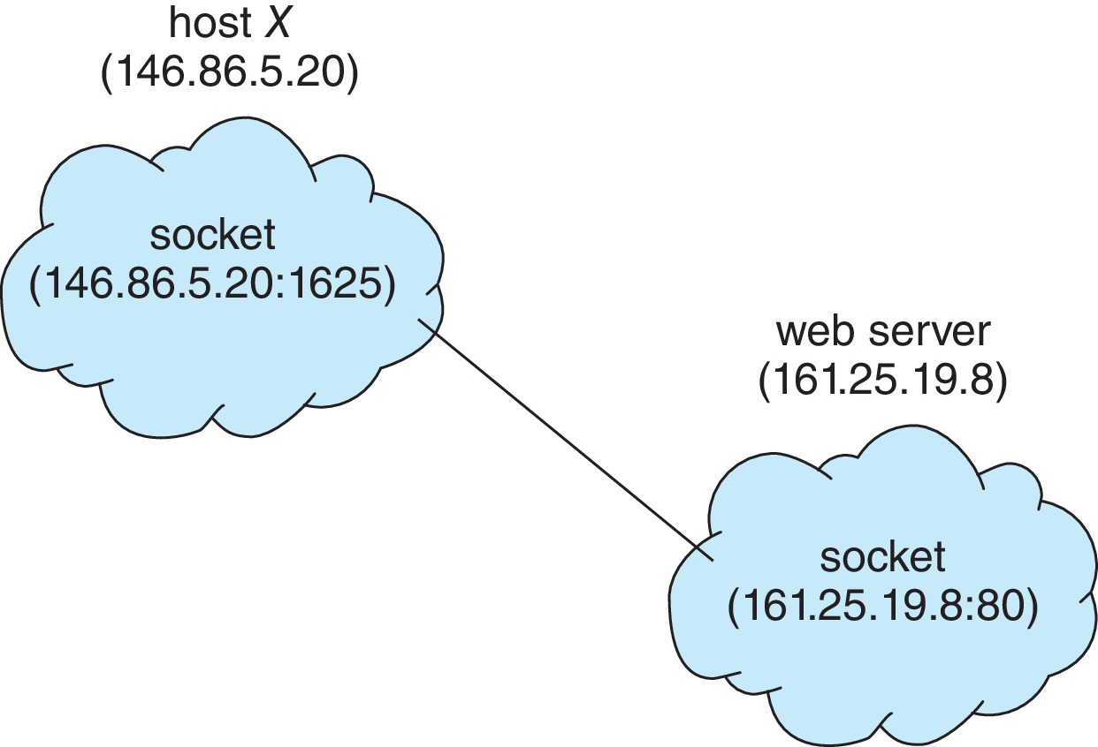
Socket
Interprocess Communication (IPC)
Communication endpoints between processes on distant machines
Based on client-server model
A socket is identified by an IP address and a port number
IP address: computer identifier over network
Port number: program identifier on a computer

Slide 25
Socket
Interprocess Communication (IPC)
Connectionless (UDP) socket
No connection required
Data transmitted as datagrams
Loss data possible
Fast
Less reliable than TCP socket
Connection-oriented (TCP) socket
A logical connection required during data transfer
Data transmitted as streams of bytes
Re transmission
Slower than UDP socket
Reliable

Slide 26
Socket: Connectionless (UDP) socket
Interprocess Communication (IPC)
SERVER
CLIENT
Create socket
Create socket
Bind socket to network address (IP, port)
Bind socket to network address (IP, port)
Data exchange
Read/Write messages
Read/Write messages
Close socket
Close socket

Slide 27
Socket: Connection-oriented (TCP) socket
Interprocess Communication (IPC)
SERVER
CLIENT
Create socket
Create socket
Bind socket to network address
(IP, port)
Open socket to accept connections
Connection establishment
Accept connections from client
Send connection request
Read/Write messages
Read/Write messages
Data transfer
Close socket
Close socket

Slide 28
And other ...
Interprocess Communication (IPC)
Signal handling
RCP (Remote Control Protocol)
Message Passing
Self-learning

Slide 29

Topic 1

Slide 30
REVIEW QUESTIONS
Explain the difference between a program and a process.
Describe the context-switch procedure.
When will a process move into the zombie state? How to solve this problem?
When will a process move into the orphan state? How to solve this problem?
What is the role of a PCB? The following statement is true or false: “A PCB of a process resides in memory zone reserved for this process”.

